Slide 1
Production Preparation Process (3P) Kickoff Event
Notes:
DO: Use this 3P Kickoff 3 day event to collect information, prepare for and define the content and scope of a 3P Workshop Event. This is the equivalent of Toyota’s information phase of 3P.

Slide 2

Other Modules In This Series
5S
Standard Work
Total Productive Maintenance (TPM)
Cell Design/ Production Preparation Process (3P)
Intro to Lean
Kaizen
Kanban
Problem Solving
Poka Yoke Quality Systems
Process Mapping
Single Minute Exchange of Dies (SMED)
Transaction Process Improvement (TPI)
Value Stream Mapping (VSMi®)
Visual Management
For More Information Please Contact:
Mark DeLuzio, President and CEO
+1.860.234.0915
mark.deluzio@leanhorizons.com
Strategically Creating Value Through the Elimination of Waste
2

Slide 3
This document contains confidential
and proprietary information owned
by Lean Horizons Consulting, LLC.
Any disclosure, use, copying or
distribution of this information without the express written consent of Lean Horizons Consulting is strictly prohibited.

Slide 4
Ground Rules for Event
Safety first (use personal protective equipment)
Active participation by all
Start and end on time
All electronic gadgets (phones, pagers, etc) turned to “off” or “silent”
Computers to be used only when instructed
Keep an open mind to change
Don’t let “perfect” get in the way of “better”
Notes:
DO: Perform Group Introductions. Or Take two minutes to learn about another person and then 1 minute to present them to the group e.g. name, where were they born, where do they live now, family – married, children, hobbies, personal qualities, position, career, what do they like about work, what do they expect to get from this event.
Pick an ice-breaker or exercise to warm the team up to the event. (Icebreaker Example: Everyone uses their name tent and writes a “Personal License Plate” in which they have 2 minutes to creatively use a total of 7 letters or numbers to tell us something about themselves. Examples “LV2SAIL” OR “DADOV5”
DO: Review Event Ground Rules.
ASK: “Does anyone have any rules they would like to see added?”
ASK: “Does everyone agree to these?”

Slide 5
Creative Stimulation Exercise
Objective
To stimulate the “creative thinking” to kick-off the event.
Instructions
Time to Complete
Given a piece of paper and a pencil, draw from memory a picture of an object.
5 minutes
Deliverable
Be prepared to show your drawing to the team.
Notes:
DO: Ask each team member to draw their own version of an object. The object could be anything that each team member could recall an image of from memory e.g. an Elephant, the Statue of Liberty, the Mona Lisa, a Shark, the Taj Mahal, Michelangelo’s David, a Moose, the Eiffel Tower, Van Gogh’s Sun Flowers, Big Ben, a Skunk etc
SAY: “3P is largely a creative thinking event. Drawing from memory stimulates the brain to start the thinking process.”

Slide 6
Goal of 3P
Develop and implement a new product/process with the highest quality, lowest cost, in the shortest time
PROCESS STEP 1
PROCESS STEP 2
PROCESS STEP 3
PROCESS STEP 4
Leadership
Awareness/ Commitment
3P Kick-Off
3P Workshop
Implement
Apply
learning
to next 3P
Notes:
DO: Introduce the notion of Deming’s PDCA in relation to 3P as an iterative process of creative divergence and constructive convergence and refinement.

Slide 7
3P Roadmap to Success
PROCESS STEP 1
PROCESS STEP 2
PROCESS STEP 3
PROCESS STEP 4
Leadership Awareness/ Commitment
3P Kick-Off
3P Workshop
Implement
Apply
learning
to next 3P
Attend 3P Executive Overview
Readiness Assessment
Prerequisites
Commitment to 3P process
3P Overview Training
Define the requirements
Create 3P Lab
Prepare Event Charter & Plan
Detailed 3P Training and Exercises
Application of 3P Methodology to Design/Process
Creation of Implementation Plan
Plan equipment, fixtures, tooling
Develop support systems
Install and qualify
Create Standard Work

Slide 8
3P Roadmap to Success
PROCESS STEP 1
PROCESS STEP 2
PROCESS STEP 3
PROCESS STEP 4
Leadership Awareness/ Commitment
3P Kick-Off
3P Workshop
Implement
Apply
learning
to next 3P
3P Overview Training
Needs and
Objectives
Current Performance
Create
3P Lab
Plan Workshop and Event Charter

Slide 9
3P Kick-Off Structure
3P Overview Training
Needs and
Objectives
Current Performance
Create
3P Lab
Plan Workshop
and Event Charter
3P Five Steps and Iterative Process, 16 Catchphrases, checklists
Application of Lean tools in 3P
Select Product/ Process
Define Relationship to other systems and processes
Identify Voice of the Customer - External & Internal
Determine the current state
Collect Performance Data
Waste and Gap Analysis
Define requirements for Rapid Prototyping
Prepare 3P Lab for Workshop Event
Define and Select Team
Develop Plan for 3P Workshop
Create 3P Event Charter

Slide 10
3P Planning
Day | Key Learnings | Daily Deliverables
Day 1 | 3P Overview Training Objectives and Needs | Understand 3P process Design Specification
Day 2 | Current State Performance 3P Lab Requirements | Process Maps System Relationships Performance Metrics Simulation/Prototyping Facilities
Day 3 | Event Scope and Requirements Prepare for Team Final Report-Out | 3P Event Plan and Charter Final Report-Out to Management

Slide 11
3P Overview
3P Overview
Training
Needs and
Objectives
Current
Performance
Create 3P Lab
Plan Workshop
and Event Charter
Objectives:
Define 3P objectives and principles
Prerequisites for successful 3P
The 4 phases of 3P
The 5 step iterative creative process of 3P
Eliminating waste using Lean tools and the 16 catchphrases
Planning for implementation
Notes:
DO: Review chapter objectives.

Slide 12
Exercise: “Reds and Yellows”
3P Training
Objective
To demonstrate trust and cooperation.
Instructions
Time to Complete
2 or more teams of any number are each provided with a red and a yellow counter.
The objective is to maximize your own team’s score (see score card).
Each team to decide it’s play strategy.
One Negotiator from each team play counters simultaneously.
Hold 8 rounds & review. Hold further 12 rounds & review.
20 minutes
Deliverable
Maximize team score.
Notes:
The essence of this game is to understand that by cooperating, teams can score more than by competing with one another.
The score card on the next slide incentivizes teams to try to outsmart and cheat on the other teams. In almost all cases teams end up scoring less than if they cooperated.
Leave the score card slide on the screen or print copies for each team.
The game can be run with a Red and Yellow Counter or a Quarter and a Dime or any other easily distinguishable counters.
How to Play
Split the delegates in to 2 or more teams (2 to 5 works best) and have them sit away from the other teams but in the same room.
Allow 2 or 3 minutes for the teams to discuss their strategy and appoint a Negotiator.
The Negotiator from each team then all stand in one area (around a desk corner works well) with a Red counter concealed on one hand and the Yellow in the other.
Having previously determined their play strategy from their team colleagues, they play the appropriate color by placing it on the table when asked to “Play” by the facilitator. All Negotiators place their counters at the same time.
The scores for each team are then recorded on a flipchart (as set-out below) according to the Score Card.
The facilitator should play 4 or 5 rounds first and then let the Negotiators have another discussion with their team.
Complete the first 8 rounds and sub-total the scores.
Discuss the relative scores. Best score possible is 8x3=24, worst score is 8x-3=-24. All teams could have scored 8 (8x1) if they had cooperated. Usually all teams score less than 8.
Next, after a brief discussion with their teams get all the Negotiators to leave the room and agree (or disagree) a strategy going forward.
Let them debrief their teams before playing the next 12 rounds. Allow the Negotiators to discuss with their teams after 5 or 6 rounds.
Complete the final 12 rounds making a total of 20.
To stir the teams up a bit, before the last two or three rounds, remind them that a Red now could be worth 3 points to the teams.
Add up the subtotal and the total for all 20 rounds and discuss scores relative to a potential score for all teams of 20.
Conclusion should be that cooperation, such as between departments or between customers and suppliers in the long run is better than trying to score points against each other!

Slide 13
“Reds & Yellows” Score Card
3P Training
Played |  | Scores
Yellows | Reds | Yellows | Reds
All | No Reds | +1 | 0
 | 1 Red | 0 | +3
Even | Even | -1 | -1
1 Yellow |  | +1 | -2
No Yellows | All Reds | 0 | -3

Slide 14
3P Defined
3P Training
Production Preparation Process (3P) is a team approach to concurrent production process and product design that delivers:
  Highest customer Quality
  At the lowest product and capital Cost
  With better Safety, Ergonomics and Less Environmental Impact
  For the required Volume
  Able to Flex to volume changes
  On Time and in the shortest project Lead Time

Slide 15
3P Defined
3P Training
3P is an advanced lean tool typically used by organizations that have experience with other lean methods
3P focuses on eliminating waste by building quality into the process through product and process design
3P starts with a clean product development slate to rapidly create and test potential product and process designs that require the least time, material, and capital resources
3P involves a diverse team in a multi-day creative process to identify several alternative ways to meet the customer's needs
Notes:
SAY: “3P is an advanced lean tool typically used by organizations that have experience with other lean methods
Kaizen and other lean tools take a production process as a given and seek to make improvements, 3P focuses on eliminating waste through product and process design.
3P seeks to meet customer requirements by starting with a clean product development slate to rapidly create and test potential product and process designs that require the least time, material, and capital resources.
3P involves a diverse group of individuals in a multi-day creative process to identify several alternative ways to meet the customer's needs using different product or process designs.
Eliminate the ‘Three D’s’ – dirt, difficult, dangerous”

Slide 16
Goal of 3P
3P Training
Least waste by integrating the ‘4M’s’ (Man, Material, Machine, Methods) of production into a good flow
Eliminate Muda (waste), Mura (variability), Muri (overloading)
Eliminate the ‘Three D’s’ – dirt, difficult, dangerous
Build quality into the process with Poka-yoke & Jidoka

Slide 17
When to use 3P – Top 5 Reasons
3P Training
New product development. Educate designers in Lean as early as possible.
Capital expenditure approval. Don't sign a Cap Ex without first doing 3P.
Product design changes. Don’t approve changes without a 3P review.
Significant changes in volume. If you didn't design the process Lean, here's a second chance.
Relocation of processes. If you're going to pick it up and move it anyway, you might as well Lean it out first.

Slide 18

Benefits
3P Training
Increased sales – extended product life cycle, early adopters increased early stage pricing
First to market – increase chances of competitor lock-out
Enhance market image as innovative producer
Improved product performance
Reduced production cost – product and capital required
Reduced development costs
Increases profitability
Notes:
SAY: “Product performance can be enhanced in two ways; 1) by involving multidisciplinary teams early, an improved solution can be found, 2) by having a fast development process, development can afford to wait for improved or cheaper technology and still make it to market on time.
Lower production costs do not naturally follow as typically 2X effort leads to ½ development time. However more focused effort and fewer iterations and mistakes can lead to improved development efficiency and lower development costs.”

Slide 19
Prerequisites for successful 3P
3P Training
Organizational lean maturity
Strategic alignment and VOC
Follow kaizen guidelines
Cross-functional associate involvement
Adequate mechanical and design capabilities
Establish 3P Lab with supplies and staff
Leadership sponsorship
Willingness to be revolutionary

Slide 20
80% of Product Cost Built-in at Design Stage
3P Training
Studies of over 5000 products by several companies reveal:
  McKinsey 75%
  BA Systems 85%
  Rolls Royce 80%
  Ford 80%
  GM 80%
  Westinghouse 80%
100
80
Committed Cost
60
Life Time Product Cost Cum%
40
20
Incurred Costs
0
Concept Design Production Use
Notes:
SAY: “Reported in Developing Products in Half the Time by Preston G Smith et.al. The research was collected from a number of sources and showed that, by the time the product had been committed to detail design, about 80% of the final product cost was locked in. Leaving only 20% for manufacturing and overheads. So Leaning admin and manufacturing processes can only affect 20% of the cost of the product! Design is where the big cost is.”

Slide 21

Project Resource Levels
3P Training
3P resourcing focuses more effort early in the process for alternatives and better planning
Typical resourcing assumes project will proceed to plan with no unforeseen problems but often results in additional unplanned resources required to finish project on time
Area under each curve is a measure of cost
3P Resourcing
Traditional Planned Resourcing
Post Release Unplanned Resourcing
Resource Level
Time
Concept Design Revisions Ramp
Traditional
3P
Notes:
SAY: “Involving more cross functional people early in the project will lead to shorter timescales for development leading to improved market position, improved product performance and cost and possibly lower development costs.”
NOTE: Lower production costs do not naturally follow as typically 2X effort leads to ½ development time. However more focused effort and fewer iterations and mistakes can lead to improved development efficiency and lower development costs.
DO: Ask if the team recognise the last minute panic behaviour illustrated by the red area?

Slide 22
Product Development Efficiency
3P Training
Extended timescales can lead to inefficiencies and an overall increase in the resource level and cost of development
Developing products too quickly can also lead to inefficiencies
Areas of inefficiency
Resource Level
Time
Optimum resourcing
Notes:
SAY: “Extended timescales lead to poor work efficiency through a start/stop work pattern and project drift – lack of focus
Developing too quickly can lead to cutting corners, duplication of effort and the law of diminishing returns – too many cooks.”

Slide 23
Six Trade-offs of Development
3P Training
Balance the development trade-offs based on financial benefit
  Early introduction will lead to longer product life cycle
  Lower unit cost will increase gross margins or market volumes
  Reduced development expense is a reduced cost or capacity for more products
  Improved product performance can increase product price.
Market Introduction Date
Product Unit Cost
Product Performance
Development Project Expense
Notes:
SAY: “Use simple spreadsheet models. More sophisticated models such as Net Present Value can obscure the relationships and reduce understanding. Spending time to get input data correct is important. Generate a simple set of relationships assuming linear responses i.e. a 1 month delay to the market is equivalent to 5% reduction in unit cost to revenues. From this data driven decision making can take place.”

Slide 24

Obstacles to Product Development
3P Training
Chaotic work environment – constant interruptions
Resources spread too thinly – resource bottlenecks
Failure to prioritize projects/tasks
Poor communication and lack of multi-disciplinary team approach
Poorly defined product requirements and constant changes
Lack of a formal design process with checkpoints
Late consideration of manufacturability
Lack of effort in concept development and evaluation

Slide 25
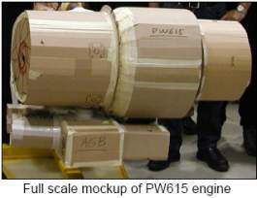
3P Principles – overarching logic of 3P
3P Training
Kaikaku - rapid revolutionary, not incremental evolutionary change
Cross-functional team based creative design
Moonshine: sketch, model, simulate, prototype, scale up
Diverge then converge, then repeat
Catch Ball and refine
Design in quality, design out waste

Slide 26
The Four Phases of 3P
3P Training
VOC/spec’s
Part Numbers
Drawings
Samples
Standards
Interfaces
Volumes
Ramp
Takt Time
Process Steps
Target Costs
7 Alternatives
16 Catchphrases
Simulations
Model Lab
Selection
Flow Chart
Takt Time
Cycle Time
Equipment Plan
Process Capacity
Standard Work
Standard Layout
Launch Phase
Information Phase
Creative Phase
Definition Phase
3P Kickoff
3P Event
3P Implementation
Notes:
SAY:”3P is an iterative process of creative divergence and constructive convergence and refinement through four phases: Information, Creative, Definition and Launch.”

Slide 27
Product and Production Interaction
3P Training
A. Product Planning
1. Production Planning
Constant Interaction Between Paths
B. Function Definition
2. Process Alternatives
C. Product Alternatives
3. Refine and Test
D. Refine and Test
5. Detail Production Process
4. Trials: Design & Process
E. Detail Design
6. Equipment Planning
9. Volume Production
8. Process Pilot
7. Equipment Procurement
10. Installation
11. Service
12. End of Life
Notes:
SAY: “This is a Concurrent Engineering method and is to illustrate that product design and production design need to run hand in hand with constant interaction between the two. This is very relevant to 3P. The traditional method is to design the product in isolation and throw it over the wall to the production department to make the best of it. Often product designers do not understand manufacturing and vice versa.”
SAY: “It is the interaction of product designers and production engineers that will achieve the best possible solution when using the 3P method.”

Slide 28
5 Steps to 3P
3P Training
Define Product/Process Design Objectives/Needs
Study Alternatives by Diagramming and Finding and Analyze Examples from Nature or other sources
Sketch and Evaluate Alternative Process Steps
Build, Present, and Select Process Prototypes
Develop Implementation Plans
Notes:
3P FIVE STEP CREATIVE PROCESS
1. Define Product or Process Design Objectives/Needs
The team seeks to understand the core customer needs that need to be met. If a product or product prototype is available, the project team breaks it down into component parts and raw materials to assess the function that each plays.
2. Study Alternatives
Diagramming: A fishbone diagram or other type of illustration is created to demonstrate the flow from raw material to finished product. The project team then analyzes each branch of the diagram (or each illustration) and brainstorms key words (e.g., roll, rotate, form, bend) to describe the change (or “transformation”) made at each branch.
Find and Analyze Examples in Nature: The project team then tries to find examples of each process keyword in the natural world. For example, forming can be found in nature when a heavy animal such as an elephant walks on mud, or when water pressure shapes rocks in a river. Similar examples are grouped and examples that best exemplify the process key word researched to better understand how the examples occur in nature. Here, team members place heavy emphasis on how nature works in the example and why. Once the unique qualities of the natural process are dissected, team members then discuss how the natural process can be applied to the given manufacturing process step.
An alternative comparison method is to ask how other industries solve similar problems. e.g. how food processing companies eliminate contamination to reduce mix to mix contamination in other processing industries or how Automotive companies solve similar problems found in the Aerospace industry and visa versa.
3. Sketch and Evaluate the Process
Sub-teams are formed and each sub-team member is required to draw different ways to accomplish the process in question. Each of the sketches is evaluated and the best is chosen (along with any good features from the sketches that are not chosen) for a mock-up.
4. Build, Present, and Select Process Prototypes
The team prototypes and then evaluates the chosen process, spending several days (if necessary) working with different variations of the mock-up to ensure it will meet criteria.
Hold Design Review: Once a concept has been selected for additional refinement, it is presented to a larger group (including the original product designers) for feedback.
5. Develop Project Implementation Plan
If the project is selected to proceed, the team selects a project implementation leader who helps determine the schedule, process, resource requirements, and distribution of responsibilities for completion.

Slide 29






3P Process
3P Training
1 – Leadership 3P Awareness | 2 – Select target area and team | 3 – Collect data
4 – Train Team | 5 – Design Criteria | 6 – 3P Lab

Slide 30






3P Process
3P Training
7 – Each team member individually draws 7 Alternatives. | 8 – Team gathers to group and evaluate ideas. Selects the top 7. | 9 – Team moonshines the 7 Alternatives.
10 – Team evaluates each Alternative. Selects the top 3. | 11 – Team moonshines the top 3 Alternatives. | 12 – Team selects Top Alternative.
7
7
7
7
7
7
7
7
3
1

Slide 31
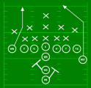




3P Process
3P Training
13 – Team refines Top Alternative. | 14 – Team completes Process At A Glance form for Top Alternative | 15 – Team prepares Implementation Plan.
16 – Present to Leadership. | 17 – Select builder & prepare fixture and tooling drawings. | 18 – Install, qualify, ramp up.
Key Actions

Slide 32

Purpose of 16 Catch Phrases of 3P
3P Training
The 16 Catch Phrases of 3P are used as guidelines for designing processes according to Lean manufacturing principles of Takt, Flow, Pull, and Jidoka.

Slide 33
16 Catch Phrases
3P Training
Production preparation should be lightning fast
Build & layout equipment for smooth material flow
Use additive equipment
Build equipment that is easy to set up
Make equipment easy to move
Use multi-purpose equipment
Make operator work stations narrow
Layout equipment for ease of operator movement
Eliminate wasted machine cycle time
Build equipment for small, swift flow lines
Use short, vertical flow lines
Build equipment for one-piece pull
Build in quick changeover
Link machines for smooth loading and unloading
Use multiple lines & untangled flows
Spiral upwards to Jidoka
Notes:
1. Production preparation should be lightning fast. Avoid over planning, use what you have, act now.
2. Build & layout equipment for smooth material flow. Flow like a river, not like a dam.
3. Use additive equipment. Buy many speedboats instead of one tanker.
4. Build equipment that is easy to set up. Design in the separation of internal and external tasks.
5. Make equipment easy to move. No roots, no vines, no pits. Put wheels on everything.
6. Use multi-purpose equipment. Simple, "just fast enough" machines that perform one function well.
7. Make operator work stations narrow. Town houses, not ranch houses.
8. Layout equipment for ease of operator movement. Remove obstruction to smooth human motion.
9. Eliminate wasted machine cycle time. Design out 'air cutting' and minimize machine movements.
10. Build equipment for small, swift flow lines. Enable Standard Work (Takt, Work Sequence, SWIP).
11. Use short, vertical flow lines. Vertical = advancing process flow, horizontal = functional.
12. Build equipment for one-piece pull. Machine level. This is probably the most critical one.
13. Build in quick changeover. Design in SMED at the machine level.
14. Link machines for smooth loading and unloading. Line stops when WIP on the line is "full work".
15. Use multiple lines & rectified flows. 'Rectified' is an odd term, electrical engineers will get it.
16. Spiral upwards to Jidoka. There are 5 steps to Jidoka, which should be pursued a step at a time.

Slide 34
Implementation
3P Training
Flowchart the production process
Determine Takt and cycles times for the process
Develop equipment plan
Determine process capacity and flex
Develop standard work plans and standard layouts
Prepare the implementation plan and critical path
Implement with rigorous review process

Slide 35
Defining Objectives and Needs
3P Overview
Training
Needs and
Objectives
Current
Performance
Create 3P Lab
Plan Workshop
and Event Charter
Objectives:
Select Product/Process for development
Define relationships to other systems and processes
Identify Voice Of Customer needs – internal and external
Translate VOC to specifications
Notes:
DO: Review chapter objectives.
SAY: “This section is aimed at defining the specification and design parameters for the product/process.”

Slide 36
Exercise: Team Selection
Need and Objectives
Objective
To demonstrate a team is better than an individual.
Instructions
Time to Complete
Follow the instructions on the next slide.
40 minutes
Deliverable
Team work provides a better solution.
Survive the trip!

Slide 37
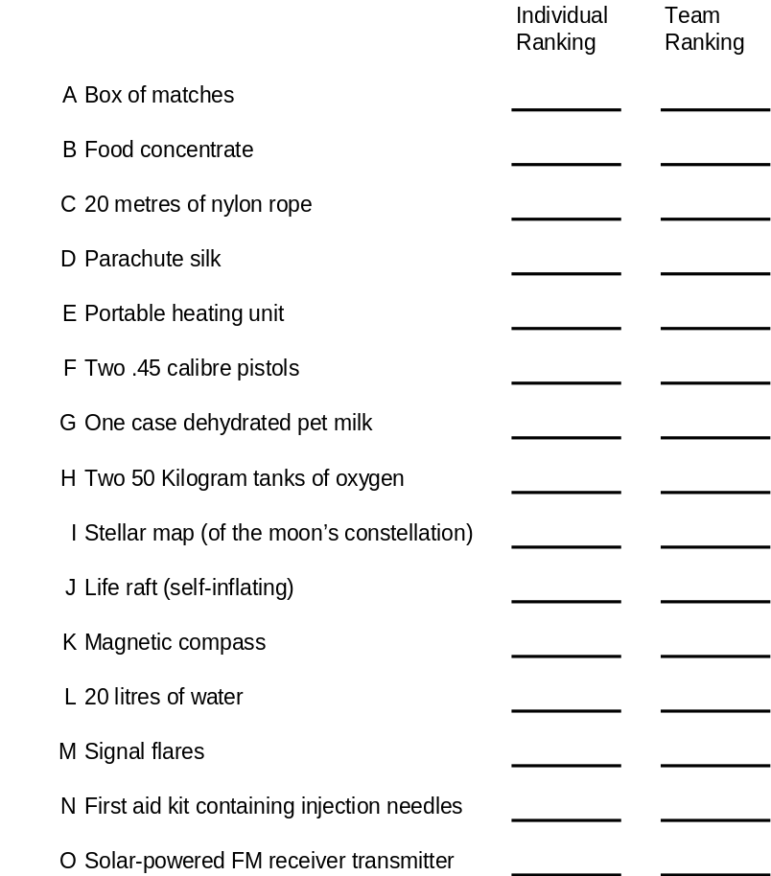
Moon Exploration Problem
Need and Objectives
You are a space crew originally scheduled to rendezvous with a mother ship on the lighted surface of the moon. Due to mechanical difficulties, however, you ship was forced to land at a spot some 300 Kilometres from the rendezvous point. During re-entry and landing, much of the equipment aboard was damaged. Since survival depends on reaching the mother ship, the most critical items much be chosen for the 300 kilometre trip. Below are listed the 15 items left intact and undamaged after landing. Your task is to reach the rendezvous point. Place the number 1 by the most important item, the number 2 by the second most important item, and so on through to number 15, the least important. Please ensure that you don’t change your individual answers during the following group discussion.
Notes:
DO: Print a copy of this slide (also found in 3P folder) for each person.
Organize in to teams or one group.
Compare individual ranks with team ranking.
Score 1 for each item Ranked correctly according to NASA’s ranking below.
NASA’s Ranking (Answers) NASA’s Reasoning
1 Two 50 Kilogram tanks of oxygen Most pressing survival need
2 20 litres of water Replacement for tremendous liquid loss on lighted side
3 Stellar map (of the moon’s constellation) Primary means of navigation
4 Food concentrate Efficient means of supplying energy requirements
5 Solar-powered FM receiver transmitter Requires line-of-sight transmission & short ranges
6 20 metres of nylon rope Useful in scaling cliffs, tying injured together
7 First aid kit containing injection needles Fits aperture in space suit
8 Parachute silk Protection from sun’s rays
9 Life raft (self-inflating) CO2 bottle may be used for propulsion
10 Signal flares Distress signal when Mother Ship sighted
11 Two .45 calibre pistols Possible means of self-propulsion
12 One case dehydrated pet milk Bulkier duplication of food concentrate
13 Portable heating unit Of no use unless on dark side
14 Magnetic compass Magnetic field not polarised
15 Box of matches No Oxygen on moon to sustain flame

Slide 38

Select Product/Process to 3P
Need and Objectives
Strategic Deployment
Business Level Value Stream Map (VSM)
Cost of Quality (COQ)
Customer Journey (CJ)
Voice Of Customer (VOC)
Notes:
SAY: “Use any or all of these methods to identify which product and or process to Lean.”

Slide 39
Strategic Deployment tie to a Lean Business System
Need and Objectives
Develop Strategic
Business Imperatives
Develop Strategic
Breakthrough Objectives
PDCA
Deploy Strategic
Breakthrough Objectives
PDCA
Identify Strategic
Value Streams
and Initiatives
PDCA
Targeted Kaikaku
And Kaizen Activity
PDCA
Notes:
SAY: “Key point is that Strategic Deployment is an iterative process, and that the appropriate lean tools should be selected in order to achieve the stated business objectives.”
Emphasize “Breakthrough”, “Breakdown”, and “Deselection”
→ FOCUS

Slide 40
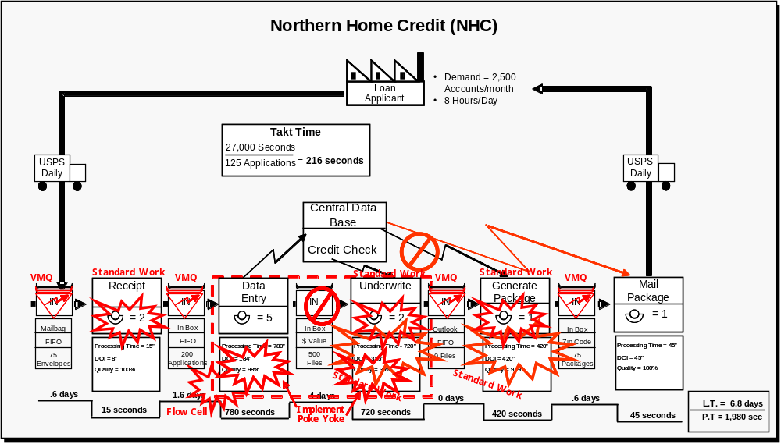
Value Stream Map
Need and Objectives
Business Level VSMi
Highlighting Project Opportunities

Slide 41
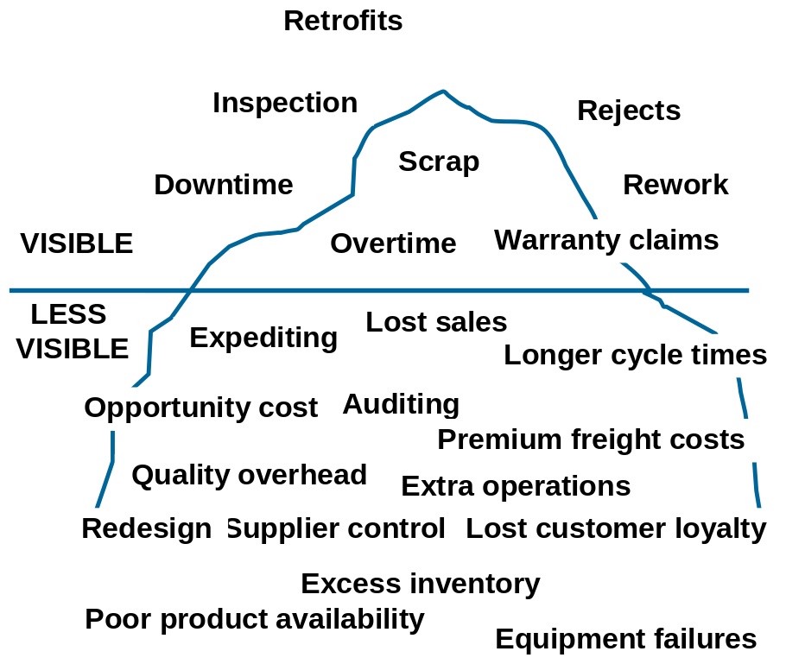
Cost of Quality
Need and Objectives
Classical cost of quality categories
Visible costs are usually much less than less visible costs
Cost of quality | Ranking
30-40% | Uncompetitive
20-30% | Poor
15-20% | Industry average
10-15% | Good
<10% | World class

Slide 42



Customer Journey
Need and Objectives
Can be carried out with Focus Groups or staff
Method
  participants to imagine they are living the journey the customer takes through the life cycle of the product /service
  decide on major steps in the journey and customer needs & wants at each step
  rate the perceived performance of the company on Likert scale (poor to great 1-5 etc) for each need & want
  categorize needs/wants as:
    attractor point – likely to attract customer
    voting point – likely to encourage customer to stay or ‘walk away’
    moment of truth – likely to make a customer proactively promote you

Slide 43

Voice Of Customer
Need and Objectives
Listening to customer needs and wants (external & internal)
Internal feedback
  Engineering Change log
  Concession notes
  Cost of Quality
Customer feedback
  surveys
  feedback forms
  focus groups
Specifications
Standards

Slide 44
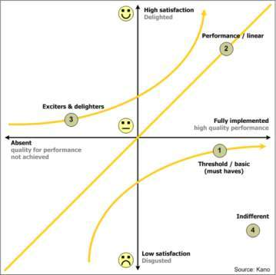
Review VOC
Need and Objectives
A detailed understanding of the customer’s requirements
A common language for the team going forward
Key input for the setting of appropriate design specifications for the new product or service
A highly useful springboard for product & process innovation.

Slide 45
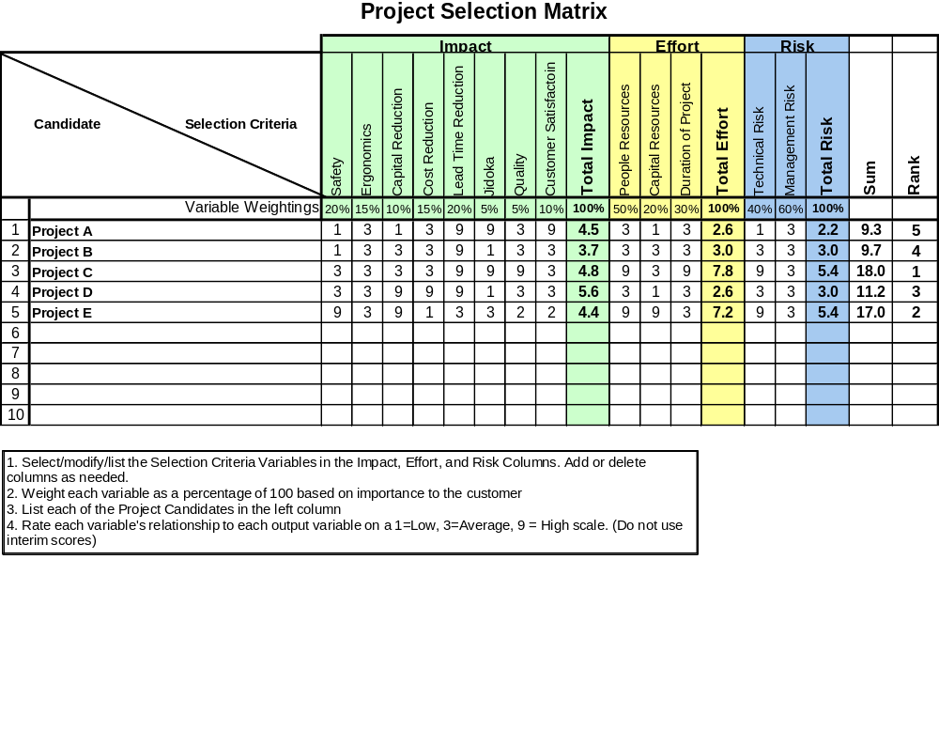
Project Selection Matrix
Need and Objectives
Notes:
Project Selection Method 1: The Project Selection Matrix is a ranking tool based on selection criteria. Use a scoring system to help to clearly prioritize projects e.g. High = 9, Med = 3, Low =1.

Slide 46
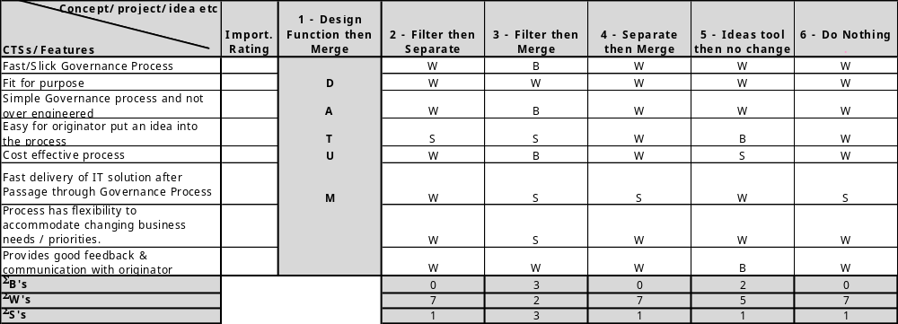
Pugh Matrix – Comparative Ranking Method
Need and Objectives
List projects to be evaluated across the top
List CTSs (Critical to Satisfaction)/Features down the left hand side
Rank each project against current or datum OR against each other
Notes:
Project Selection Method 2: The Pugh Matrix compares each project against a datum and ranks them relatively.
CTSs means Critical to Satisfaction and includes al CTs such as Critical To Quality, Critical To Delivery, Critical To Cost etc.

Slide 47
Selection Grid
Need and Objectives
Axis (X, Y, Z) | Lo/Bad | Hi/Good
Profit/Margin | Poor | Good
Competitive position | Disadvantaged | Advantaged
Customer satisfaction | Expected | Delighter
Timescale | Long | Short
Value potential | Low value | Hi value
Cost of implementation | Low cost | High cost
Revenue stream | Poor | Good
Assets employed | Consumes assets | Little impact on AE
Payback | Long >3yrs | Short <1yr
Impact on quality | Low | High
Impact on safety | Low | High
Meets objectives | No | Yes
Difficulty | Low probability of success | High probability of success
Size = Z axis
Hi
C
B
Y axis
D
A
E
Lo
Lo
X axis
Hi
Projects A - E
Notes:
Project Selection Method 3: Project Selection Grid is simple and visual and can prioritize projects using any three parameters. For more complex criteria use the Project Selection Matrix or Pugh Matrix.

Slide 48
Break into manageable projects
Need and Objectives
Complex products and processes may need to be segmented due to limitations in current technology, space, cost, ‘laws of nature’
Might initially focus on final assembly, then later look at components
3P Design Team needs to revisit the Charter and make any adjustments to scope and prioritize sequence
Risk of sub-optimization – need to Catch Ball up and down stream

Slide 49
Product/Process Selection
Need and Objectives
Objective
To select the product and or process to be Leaned.
Instructions
Time to Complete
Use any of the methods described above or other to select or review the product /process to be Leaned.
Provided by facilitator
Deliverable
Present your decision and reasons to management and colleagues.
Notes:
DO: Ensure that the product or process has been selected taking in to account the voice of the customer and fits with the strategic goals of the organization.
If the product/process has already been selected, ask the team to review their selection in the light of the above.
Ensure that a clear definition of the product/process is established and that this is agreed by relevant stakeholders.

Slide 50
Define Relationships to Other Systems and Processes
Need and Objectives
Define the scope of the 3P event within the New Product Introduction (NPI) process
Determine the System Architecture and Hierarchy for the product/process
Define the Relationships and Interfaces for the product/process
Notes:
NOTE: This section is aimed at defining the interfaces of the chosen product or process and how it relates to the whole. On the rare occasion that the product or process is not part of a larger system or process, this section can be omitted.

Slide 51
NPI Process Scope
Need and Objectives
Map the current or intended New Product Introduction process (NPI)
Note the interfaces and hand-offs required
Define the scope of the 3P Workshop and Implementation phases
Needs Identification
Planning
Design
Trials
Production
Install
Service
Design Alternatives
Prototyping
Detail Design
Process Design
Equipment Specification
Notes:
What: Determine the current New Product Introduction process and the scope of the 3P event. Only outline the total process but provide more detail within the scope of the project.
Why: The purpose of this analysis is to understand the process and interfaces that the product/process will encounter, who and what will need to be taken in to account during the 3P Workshop and Implementation phases of the project e.g. other departments, suppliers, systems, sub-systems etc.
How: This could be mapped as a Process Map, VSM or other method.

Slide 52
System Hierarchy
Need and Objectives
Understand the system architecture and define the relationship of the product/process to be Leaned as a part of the total system
Complete Product or Process
Major System A
Major System B
Major System C
Major System D
Sub-system/ Module B1
Sub-system/ Module B2
Sub-system/ Module B3
Sub-assy B1.1
Sub-assy B1.2
Sub-assy B1.3
Sub-assy B1.4
Sub-assy B1.5
Comp. B1.4.1
Comp. B1.4.1
Comp. B1.4.1
Comp. B1.4.1
Comp. B1.4.1

Slide 53
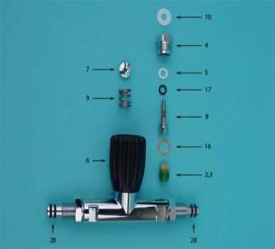
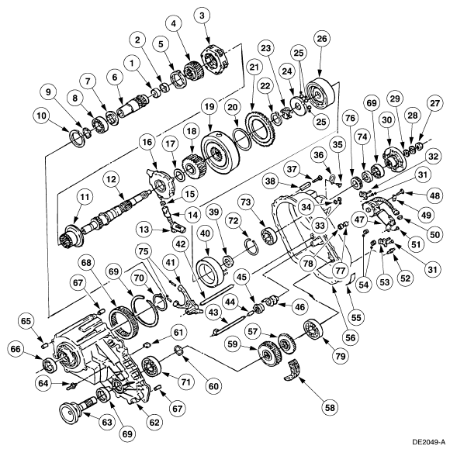
Exploded Assembly
Need and Objectives
Use drawings and exploded views to visualize product or process

Slide 54
Relationship Diagram
Need and Objectives
1/3
Draw the relationship diagram of the product/process to the system
Show the number of inputs and outputs e.g. 1/3 input/output
Define the interfaces
Describe the requirements for each interface
2/1
1/2
1/2
3/0
Notes:
NOTE: Can use SIPOC (Supplier, Input, Product/Process, Output, Customer) analysis or other relationship definition. The objective is to understand and have data on how the product/process will interact with and fit with other systems, sub-systems and components/processes.

Slide 55
Define Architecture, Relationships and Interfaces
Need and Objectives
Objective
To understand the system architecture and how the product/process will interface with other systems
Instructions
Time to Complete
Outline the current NPI process and detail map the NPI process within the project scope.
Draw the System architecture and hierarchy and detail the product/process to be Leaned.
Develop a Relationship Diagram or similar to define the interfaces.
Summarize the key elements and interfaces.
Provided by facilitator
Deliverable
Capture your summary in a presentable format.

Slide 56
Understanding Customer Requirements
Need and Objectives
Voice Of Customer (VOC)
Converting “fuzzy” VOC feedback into workable specifications
Developing an Affinity diagram of requirements
Notes:
NOTE: This section is aimed at defining the interfaces of the chosen product or process and how it relates to the whole. On the rare occasion that the product or process is not part of a larger system or process, this section can be omitted.

Slide 57
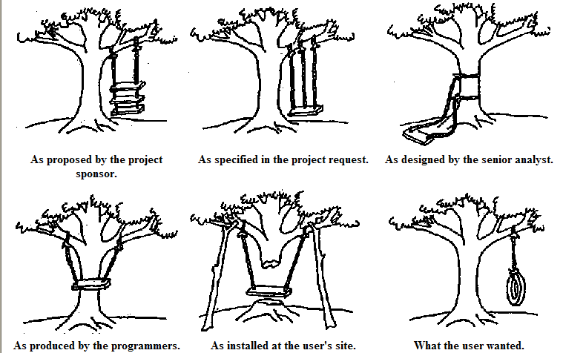
The importance of defining the requirements
Need and Objectives

Slide 58
Voice Of Customer at Product/Process Level
Need and Objectives
Listening to customer needs and wants (external & internal)
Internal feedback
  Engineering Change log
  Concession notes
  Cost of Quality
  Key personnel interviews
Customer feedback
  surveys
  feedback forms
  focus groups
Specifications
Standards/legal requirements

Slide 59

Interviews regarding current process/design
Need and Objectives
Operators
Supervisors
Inspectors
Managers
Material Handlers
Maintenance
Installers
Tech Support

Slide 60
Creating Specifications from Fuzzy VOC
Need and Objectives
Often Voice Of Customer is stated in general terms, unclear or “fuzzy”
Take each statement and turn it in to clearly defined, measurable goal – focus on benefits not features
Example:
“I want a fast service” | Measure: time from receipt of order to order fulfilment Nominal target: 5 days Tolerance: +/- 2 days
“It must have good quality” | Measure: number of marks visible to the naked eye in 500 lux of light Nominal target: 0 defects per item Tolerance: + 1 defect

Slide 61
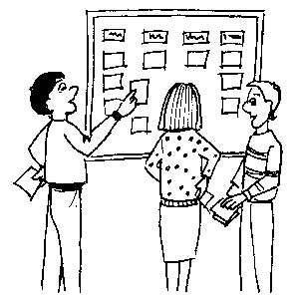
Grouping and Analyzing Specifications with an Affinity Diagram
Need and Objectives
Capture all requirements on Post-Its
Stick each Post-It onto a large surface (wall)
Group under logical clearly defined headings
Place key specifications towards the top
Combine and simplify until the team is satisfied they have captured the important requirements.
Affinity Diagram
Notes:
NOTE: Only use this step if specifications are not clearly defined. Select the ‘vital few’ requirements and turn them into clearly defined specifications. Define in terms of benefits not features. This allows designers to meet the specification in a number of different ways. Detailed specifications ‘boiler plate’ can be referred to but included as appendices or separate documents.

Slide 62
Turn VOC into Specifications
Need and Objectives
Objective
To clearly define the key specifications and requirements
Instructions
Time to Complete
Review VOC, specifications and standards and organize into clearly defined, simple-to-understand requirements.
Provided by facilitator
Deliverable
Affinity Diagram or similar of requirements.

Slide 63
Determine Current Performance
3P Overview
Training
Needs and
Objectives
Current
Performance
Create 3P Lab
Plan Workshop
and Event Charter
Objectives:
Undertake Muda walk and observation of current process/design
Complete “before” video and take digital photos
List issues for safety, ergonomics, quality, delivery, cost
Collect data on Key Performance Indicators
Brainstorm and complete Affinity Diagram process
Notes:
DO: Review chapter objectives.
SAY: “This section is designed to understand the performance required of the product or process.”
NOTE: This is done by reviewing the performance of the existing product/process and undertaking a gap analysis with that of the desired performance. If this is a brand new product/process compare it to similar products/processes.

Slide 64
What is “Waste”?
Current Performance
Types of Waste | Descriptions
1. Muda | Any activity that consumes resources without creating value for the customer
2. Mura | Unevenness in a process; for example an uneven work pace causing people to hurry and wait
3. Muri | Overburdening, overloading, or stressing of resources (such as people or equipment)
Notes:
DO: Explain the three types of waste that originate from the Japanese.

Slide 65
The Eight Wastes Defined
Current Performance
Wastes | Definition
Defects | Process steps that result in scrap, rework or re-processing.
2. Over Production | Producing more product than is required at the current time.
3. Waiting | Periods of inactivity while waiting for the next process step to begin.
4. Non-Utilized Talent | Unused creativity and underutilized human capital.
5. Transportation | Product moving from person to person or between locations.
6. Inventory | Unprocessed or partially processed materials, or undelivered finished goods.
7. Motion | Excessive movement by people or machines.
8. Extra Processing | Unnecessary work beyond what is required to meet customer requirements.
Notes:
Mnemonics: DOWNTIME
DO: Ask the class to provide examples of the 8 wastes. Capture their answers on a chart paper. The participants can write the answers in their workbooks.

Slide 66
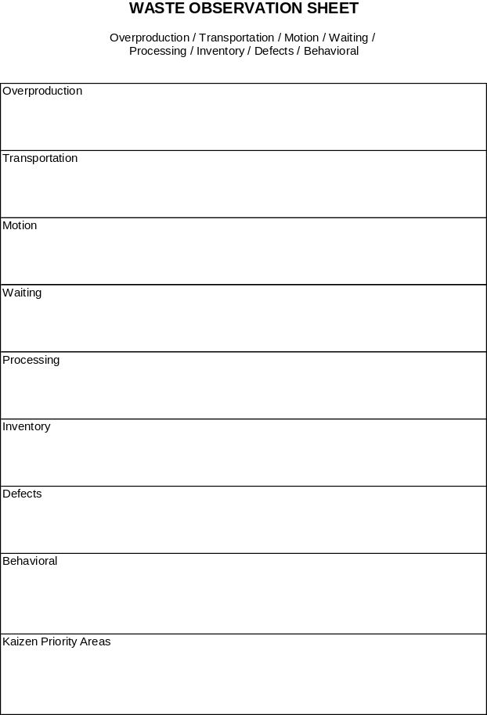
Muda Walk Observation
Current Performance
Examine waste closely
Independently collect examples
Compare notes
Prioritize
Save for comparison to design alternatives

Slide 67
Example Data to Review
Current Performance
Part Numbers
Drawings
Samples
Time: process time, lead time and value added time
Changeover times
Typical batch sizes
Quality (process outputs)
Number of Poka Yokes
Reliability
Cost Targets
Ramp schedule
Delivery peak volume
Scalability (volume fluctuations)
Takt time
Replenishment times
Standard WIP
Layouts and people
QFD or Strategic Deployment
Process steps or maps
Value Stream Map

Slide 68
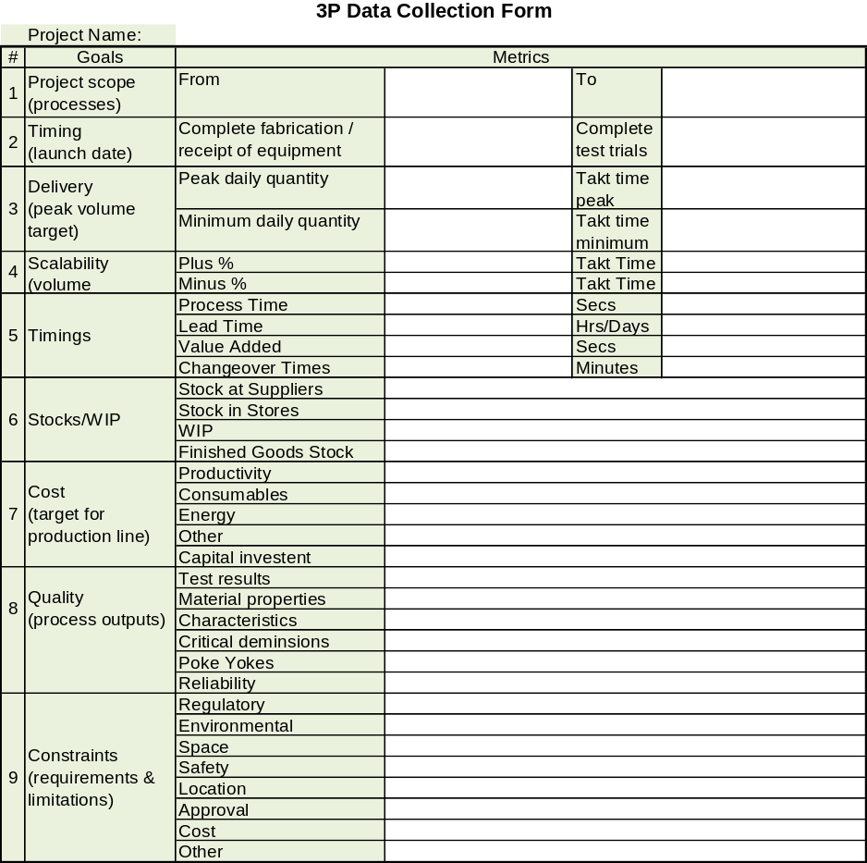
3P Data Collection Form
Current Performance
Prepare Data Collection Form identifying key metrics and constraints

Slide 69
Take Muda Walk
Need and Objectives
Objective
As a team, observe the process, dissect the product
Instructions
Time to Complete
Undertake Muda Walk and observation of current process or design
Observe and document repetitive builds (multi-cycle analysis)
Complete Motion Analysis (Eliminate, Combine, Modify, Simplify)
Complete “Before” Video/photos
Collect data
Complete Affinity Diagram of all opportunities
Provided by facilitator
Deliverable
List issues observed for safety, ergonomics, quality, delivery, cost.
Complete the Affinity Diagram.

Slide 70
Create 3P Lab
3P Overview
Training
Needs and
Objectives
Current
Performance
Create 3P Lab
Plan Workshop
and Event Charter
Objectives:
Define requirements for rapid prototyping and modeling
Obtain approval and budget
Prepare 3P Lab for Workshop event
Notes:
DO: Review chapter objectives.

Slide 71
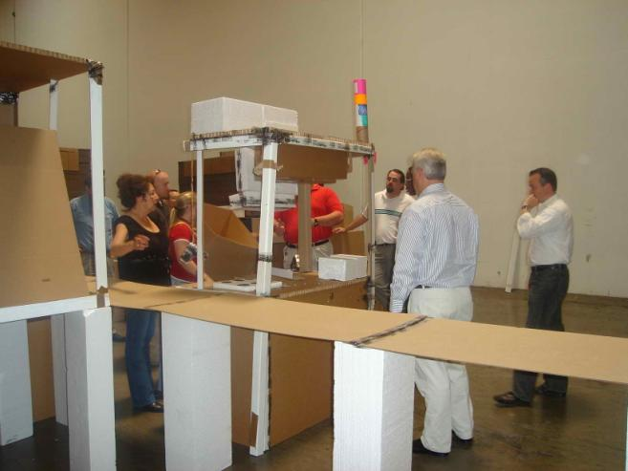
What is a 3P Lab?
Create 3P Lab
A facility where ideas and concepts can be mocked-up, modeled or prototyped and then tried to rapidly assess a number of alternatives
Can be mathematical, CAD, virtual or physical modeling
Self equipped and adequately staffed
Notes:
DO: Explain that the purpose of a 3P Lab is to be able to evaluate ideas and try them rapidly often called “trystorming” as opposed to a purely cerebral exercise such as “brainstorming”.

Slide 72
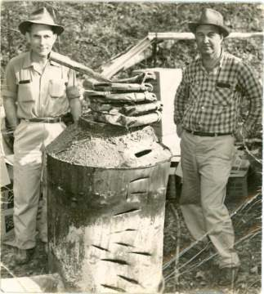
Rapid Prototyping sometimes called “Moonshining”
Create 3P Lab
Not conventional thinking
Many people will not like it
You may have to keep it a secret from your own organization - “skunk works”
May feel uncomfortable until people come to accept it

Slide 73
Examples of Materials and Equipment Needed
Create 3P Lab
Wood, particle board, foam, polystyrene, cardboard etc.
Nails, bolts, screws, staples, glue, duct tape etc.
Hinges, slides, casters, steel rod, bungee cords etc.
Plastic, plasticine, clay, cement etc.
Wood and metal working equipment.
Rapid Prototyping equipment.
Facilities – space, power, secure.
Computer modeling – CAD, virtual reality, MathCAD, Minitab etc.
Drawing equipment (colors) – pens, pencils, paper, ruler etc.
Test/measurement equipment.

Slide 74
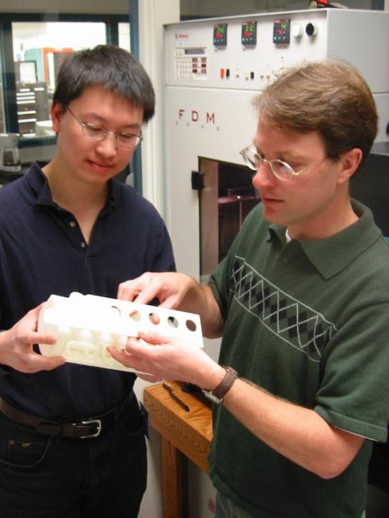
Other Considerations
Create 3P Lab
Do you need external facilities/support?
What budget will be required for this facility and materials etc?
Do you have approval to set up the 3P Lab?
How will you use it, staff it and decommission it after use?
Notes:
Image from WEB at http://www.lbl.gov/Publications/Currents/Archive/images/Mar-22-2002/DesignWorks2.jpg

Slide 75
Create 3P Lab
Create 3P Lab
Objective
Create 3P “Moonshine” Lab Facility and Resources
Instructions
Time to Complete
Brainstorm requirements for the 3P Lab.
Obtain approval and budget.
Develop a material, equipment, facility and personnel checklist.
Secure resources required or a plan to obtain resources prior to 3P Workshop event.
Provided by facilitator
Deliverable
3P Lab or Plan for same.

Slide 76
Plan Workshop and Review Event Charter
3P Overview
Training
Needs and
Objectives
Current
Performance
Create 3P Lab
Plan Workshop
and Event Charter
Objectives:
Review agenda for 3P Workshop
Develop Charter for 3P Event
Obtain management approval for Event Charter
Prepare management report out
Notes:
DO: Review chapter objectives.

Slide 77
3P Workshop Agenda
Plan Workshop
Day | Key Learnings | Daily Deliverables
1 | Process Analysis Key Functions | Process diagram
2 | Back to basics/Nature 16 Catch Phrases | Function Sketches 7 Alternatives (for each process step)
3 | Visual Creativity Selection Criteria | Evaluate 7 Mockup
4 | Physical Limits/Interfaces Duration & Effort | Refine & Combine/Select Top 1 Process @ Glance Implementation Plan
5 | Prepare for Team Final Report-Out | Final Report-Out to Management
Notes:
NOTE: Make any modifications or inclusions/deletions to Workshop event as required by nature of 3P event.

Slide 78
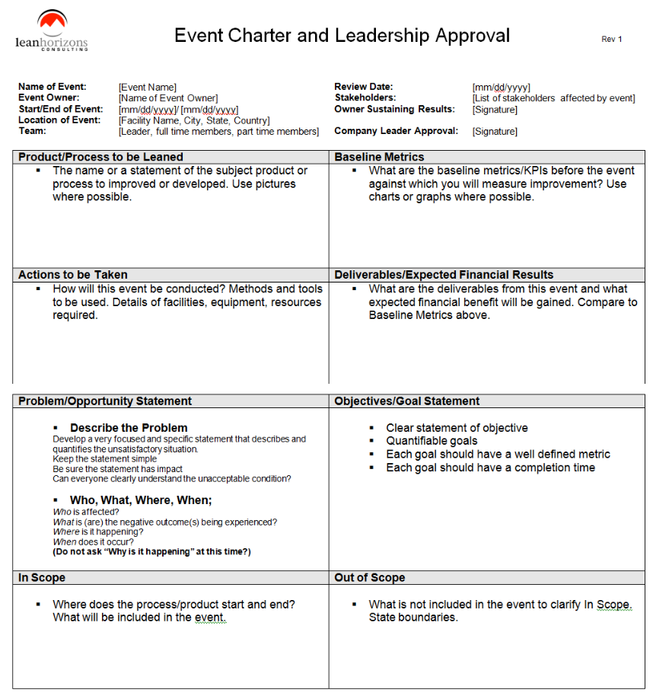
3P Charter and Leadership Approval
Plan Workshop
After 3P training, data collection, and review, prepare Event Charter and Leadership Approval document identifying key metrics and objectives

Slide 79
Exercise: Review Team Charter
Plan Workshop
Objective
As a team, review the event charter.
Instructions
Time to Complete
Review the event charter and validate event objectives and project boundaries.
20 minutes
Deliverable
Make any necessary modifications to charter.

Slide 80
Prepare Final Report Out and Budget
Plan Workshop
Charter
Objectives
Top Design Metrics
Workshop Plan
Benefits Summary

Slide 81
Management Review
Plan Workshop
Objective
Management review of conclusions from the data and finalized charter
Instructions
Time to Complete
Present the team’s conclusions from the data and the finalized charter to management for approval.
20 minutes
Deliverable
Approval of charter and event direction.

Slide 82
Other Modules In This Series
5S
Standard Work
Total Productive Maintenance (TPM)
Cell Design/ Production Preparation Process (3P)
Intro to Lean
Kaizen
Kanban
Problem Solving
Poka Yoke Quality Systems
Process Mapping
Single Minute Exchange of Dies (SMED)
Transaction Process Improvement (TPI)
Value Stream Mapping (VSMi®)
Visual Management
For More Information Please Contact:
Mark DeLuzio, President and CEO
+1.860.234.0915
mark.deluzio@leanhorizons.com
Strategically Creating Value Through the Elimination of Waste
82

